Slide 1

Workforce Planning & Operational Analytics System
An Evaluation of Data-Driven Workforce Decision Making in E-Commerce Fulfilment Centres
MSc Computer Science Project Proposal
Candidate: Mohammed Sameer
Supervisor: Neeli khalid

Slide 2


BACKGROUND & PROBLEM STATEMENT
Dynamic Operations Challenge
Risks of Spreadsheet-Planning
E-commerce fulfilment operations experience severe, erratic workload shifts driven by flash sales, intense seasonal promotions, and dynamic consumer purchasing behavior.
Overreliance on spreadsheet models and planner intuition frequently triggers costly operational issues: excessive overstaffing overheads or severe understaffing that compromises core SLAs.

Slide 3
PROJECT AIM & OBJECTIVES
Aim: To design and evaluate an enterprise workforce planning platform integrating operational analytics, advanced performance reporting, and automated machine learning forecasts.
Literature: Synthesize studies on capacity planning & BI analytics.
Metrics: Identify & categorize key warehouse labor KPI definitions.
Spring Platform: Develop a secure Spring Boot enterprise backend solution.
Forecasting: Embed Python-driven predictive demand modeling modules.
Reporting: Build modular PDF/Excel data export engines for operations teams.
Validation: Run target simulations to evaluate forecasting accuracy benefits.

Slide 4
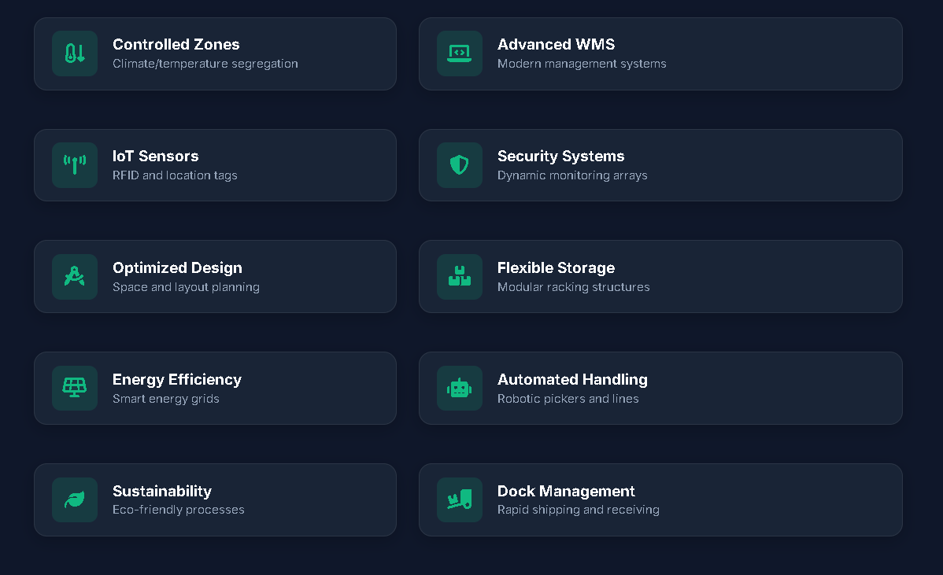
LITERATURE & RESEARCH GAP
Target Areas of Investigation
Workforce Planning: Focused on shift scheduling algorithms, flexible resource leveling, and automated workload capacity models.
Operational Analytics: Exploring real-time KPIs, historical patterns, and performance metrics dashboards.
The Gap: Most math-heavy studies ignore end-user software integration. This project implements a unified interface bridging prediction engines to management dashboards.

Slide 5






CORE RESEARCH QUESTIONS
Primary Query
Key Metrics
ML Advantage
How can operational dashboards improve workforce utilization decisions in dynamic environments?
What specific real-time operational data patterns influence labor planning efficiency?
Can basic predictive regression outperform historical manual estimates in real-world scenarios?

Slide 6
PROJECT METHODOLOGY
2. Analysis
4. Code Dev
Conduct EDA to uncover workload patterns
Construct Spring Boot REST APIs and user dashboards
1. Collection
3. Modeling
5. Testing
Assemble shift datasets and order transaction histories
Train and tune ML demand forecast modules
Assess end-to-end prediction correctness

Slide 7


SYSTEM ARCHITECTURE
Platform Tech Stack
Frontend: Modern responsive interface built on vue.js
Backend: REST API service powered by Spring Boot, controlling authentication and shift routing.
Database: Relational PostgreSQL storage managing system records, schedules, and analytics.
Forecasting: Python service executing regression algorithms for automated demand calculations.

Slide 8


SYSTEM MODULES & USER ROLES
Defined Security Roles
Underlying Modules
Admin: Oversees platform configurations & system settings.
Authentication: Secure JWT flow containing role authorizations.
Ops Manager: Monitors real-time KPIs and approves scheduling requests.
Employee Registry: Individual availability and core skillset matching.
WP Planner: Schedules shift windows & handles labor requirements.
Shift Engine: Interactive planners allocating resources seamlessly.
Analyst: Reviews historical trends and exports monthly cost reviews.
Reporting Core: Modular PDF and XLSX output generation routines.

Slide 9


PROJECT CONTRIBUTIONS
Anticipated Discoveries
Evaluation Model: Provides direct comparison data detailing efficiency shifts transitioning from legacy planners to real-time analytics dashboards.
Integration Framework: Offers a structured, reproducible implementation model joining core Spring databases with isolated Python machine learning environments.
Recommendations: Establishes concrete logistics operational policies for dealing with unpredictable holiday scale changes.

Slide 10

PROPOSAL SUMMARY & FOCUS
Thank you. Questions are welcomed.

